Slide 1
Study of Infant Mortality
TRICARE Beneficiaries
Fort Riley, Kansas
LTC Paul Benne, MD, MPH
SPC John Makinwa, BS, MBA, DrPH Candidate
November 2011

Slide 2
Objectives
Update of infant mortality in Kansas
Describe the Infant Mortality Rate (IMR) of the Fort Riley area
Discuss contributors to IMR
Discuss possible community collaboration

Slide 3
Definitions
Two calculations methods of Infant Mortality Rate:
  1. Simplest, universally adopted method = Infant deaths in a given year divided by the total number of live births in the same year multiplied by 1,000
  - Cross-sectional data
  - Data/statistics presented in the KDHE, Bureau of Epidemiology and Public Health Informatics’ Annual Summary and Kansas Information for Communities (KIC)

Slide 4
Definitions
Cohort rate = Infants born in a given year are followed through their first birthday and the number of deaths that occur to these infants are noted and used as the numerator for the cohort IMR (linked births-deaths file)
  - Birth cohort – Birth for a given year are linked with infant deaths that occurred in the year of birth or the next year.
  - Death cohort – Deaths for a given year are linked with births that occurred in the same year or previous year.
  Numbers using different methodologies will not match

Slide 5
Infant Mortality Rates 2011
2011 projected IMR in US 6.1 (CIA)
There are 46 governments that have better IMRs
US rates are higher than many third world countries

Slide 6
Infant Mortality Trends
2000-2009
U.S. 2008, 2009 preliminary data
Source: Bureau of Epidemiology and Public Health Informatics, KDHE; National Center for Health Statistics
Notes:
2009 data- Kansas 7.01, US 6.42
US IMR has gradually decreased over the past two decades

Slide 7
Infant Mortality Rates by Race
2007
Source: National Vital Statistics Report: Volume 58, Number 19
Notes:
White Kansas 7.0 US 5.6; Black Kansas 19 US 13.2

Slide 8
Kansas Ranked Worst among States for
Black Infant Mortality Rate (IMR), 2007
States | Black IMR
Kansas | 18.98
Oklahoma | 18.03
District of Columbia | 16.61
Missouri | 16.48
Michigan | 16.39
Rhode Island | 16.00
Indiana | 15.99
Tennessee | 15.74
Virginia | 15.41
Wisconsin | 15.18
USA | 13.24
Source: National Vital Statistics Report: Volume 58, Number 19

Slide 9
Black non-Hispanic and White non-Hispanic Infant Mortality Rates & Ratio, 1998-2009
*NH: Non-Hispanic
Source: Bureau of Epidemiology and Public Health Informatics, KDHE
Notes:
Even though rate overall has gone down gap between the black NH and white NH has widened.

Slide 10
Infant Deaths by Cause of Death
Kansas, 2005-2009
Source: Bureau of Epidemiology and Public Health Informatics, KDHE

Slide 11
Births and Deaths by Gestational Age,
KS 2005-2009 Average
All Races
Pre-term = 10%
Pre-term=61%
Live Births
Deaths
Premature babies: 10% of births, BUT 61% of deaths!
Source: Bureau of Epidemiology and Public Health Informatics, KDHE

Slide 12
How old are babies when they die?
Neonatal deaths (= <28 days old) are more common than post-neonatal deaths in all races and ethnicities
This distinction is less important today
  LBW and prematurity more important than the age of the baby
Source: Bureau of Epidemiology and Public Health Informatics, KDHE

Slide 13
Our Question
Based on cross-sectional data, 2005 to 2009 :
Kansas IMR
7.37/1,000 live births
(CI95 7.00-7.74)
Fort Riley
(TRICARE)
IMR
?
Geary/Riley County IMR
8.50/1,000 live births
(CI95 6.69-10.66)
92% of Fort Riley TRICARE births occur to residents of either Riley or Geary County
Source: Bureau of Epidemiology and Public Health Informatics, KDHE

Slide 14
Study Subjects
TRICARE beneficiaries
live births in Fort Riley, Kansas area (2005- 2009)
N= 4715
Beneficiaries included resident live births where TRICARE was the delivery payor (2005-2009) .

Slide 15
Fort Riley Area defined as:
County | Births
Chase | 0
Clay | 70
Cloud | 6
Dickinson | 147
Geary | 2101
Lyon | 8
Marion | 8
County | Births
Marshall | 7
Morris | 18
Ottawa | 7
Pottawatomie | 91
Riley | 2226
Wabaunsee | 22
Washington | 4
Total Live Births 4715

Slide 16
Characteristics of Fort Riley, KS TRICARE Beneficiaries (2005-2009)
Hospital | Irwin | (%) | Other | (%) | Total | (%) | Kansas
 | 3660 | 77.6 | 1055 | 22.4 | 4715 | 100
Maternal Race: White NH | 2572 | 70.3 | 806 | 76.4 | 3378 | 71.6 | 71.8
Hispanic | 431 | 11.8 | 83 | 7.9 | 514 | 10.9 | 16
Black NH | 415 | 11.3 | 93 | 8.8 | 507 | 10.8 | 6.8
Other/Multi NH | 128 | 3.5 | 38 | 3.6 | 166 | 3.5 | 1.7
Asian/PI NH | 85 | 2.3 | 29 | 2.7 | 114 | 2.4 | 2.7
Native Am NH | 28 | 0.8 | 6 | 0.6 | 34 | 0.7 | 0.7
Maternal Age : <15 years | 2 | 0.1 | 0 | 0 | 2 | 0 | 0.1
15-19 | 282 | 7.7 | 98 | 9.3 | 380 | 8.1 | 10.3
20-24 | 1645 | 44.9 | 444 | 42.1 | 2089 | 44.3 | 27.4
25-29 | 1110 | 30.3 | 304 | 28.8 | 1414 | 30 | 30.3
30-34 | 450 | 12.3 | 129 | 12.2 | 579 | 12.3 | 20.9
35-39 | 147 | 4.0 | 73 | 6.9 | 220 | 4.7 | 9
40-44 | 24 | 0.7 | 7 | 0.7 | 31 | 0.7 | 1.9

Slide 17
Characteristics of Fort Riley, KS TRICARE Beneficiaries (2005-2009)
Hospital | Irwin | (%) | Other | (%) | Total | (%) | Kansas
 | 3660 | 77.6 | 1055 | 22.4 | 4715 | 100
Maternal Education: <HS | 217 | 5.9 | 85 | 8.1 | 302 | 6.4 | 1.3
HS | 1046 | 28.6 | 306 | 29 | 1352 | 28.7 | 18.9
>HS | 2397 | 65.5 | 657 | 62.3 | 3054 | 64.8 | 24
Unknown | 0 | 0 | 7 | 0.7 | 74 | 0.1 | 55.9
Maternal Risk: Smoking | 502 | 13.7 | 209 | 19.8 | 711 | 15.1 | 16.1
Unmarried | 322 | 8.8 | 83 | 7.9 | 405 | 8.6 | 37.3
Gestational Hypertension | 22 | 0.6 | 42 | 4 | 64 | 1.4 | 3.9
Gestational Diabetes | 26 | 0.7 | 37 | 3.5 | 63 | 1.3 | 3.8
Ecclampsia | 50 | 1.4 | 4 | 0.4 | 54 | 1.1 | 0.2
Previous Preterm Birth | 4 | 0.1 | 40 | 3.8 | 44 | 0.9 | 2.9

Slide 18
Characteristics of Fort Riley, KS TRICARE Beneficiaries (2005-2009)
Hospital | Irwin | (%) | Other | (%) | Total | (%) | Kansas
 | 3660 | 77.6 | 1055 | 22.4 | 4715 | 100
Birth Weight: <1500 kg | 11 | 0.3 | 43 | 4.1 | 54 | 1.1 | 1.4
1500-2499 | 97 | 2.7 | 141 | 13.4 | 238 | 5 | 5.9
2500+ | 3551 | 97 | 871 | 82.6 | 4422 | 93.8 | 92.7
Prenatal Care: 1st Trimester | 2922 | 79.8 | 788 | 74.7 | 3710 | 78.7 | 69.1
2nd Trimester | 603 | 16.5 | 195 | 18.5 | 798 | 16.9 | 19.7
3rd Trimester | 111 | 3 | 42 | 4 | 153 | 3.2 | 3.7
Unknown | 22 | 0.6 | 19 | 1.8 | 41 | 0.9 | 6.4
None | 2 | 0.1 | 11 | 1 | 13 | 0.3 | 1.1
Cause of Death: Other | 9 | 50 | 8 | 47 | 17 | 48.6 | 28
Congenital | 6 | 33 | 7 | 41 | 13 | 37.1 | 23
Respiratory | 0 | 0 | 2 | 12 | 2 | 5.7 | -
SIDS | 2 | 11 | 0 | 0 | 2 | 5.7 | 15
Infection | 1 | 5 | 0 | 0 | 1 | 2.8 | -

Slide 19
Analysis of Direct and Network Births
Fort Riley, KS (2005-2009)
 | Direct | Care | Network | Care
 | Irwin | Army | Off | Post
 | Births | Percent | Births | Percent
Total delivery | 3730 | 100 | 1119 | 100
Vaginal delivery (w/o cc) | 2377 | 63.7 | 595 | 53.2
Cesarean section (w/o cc) | 492 | 13.2 | 284 | 25.4
Complicated delivery (Vag & C-cc) | 861 | 23.1 | 240 | 21.4
Source: Medical Management Database, Irwin Army Community Hospital

Slide 20
Infant Mortality Rate:
TRICARE Beneficiaries at Fort Riley Area, KS
2005-2009
Live births = 4715
Deaths = 35
IMR = 35 / 4715 *1000 = 7.42 CI95 (5.17 - 10.32)
Infant death= Death of an infant before his or her first birthday
Infant mortality rate= Number of infant deaths per 1,000 live births.

Slide 21
Average Infant Mortality Rates (IMR) for
Fort Riley TRICARE Beneficiaries with Delivery on Post vs. Off-Post (2005-2009)
Live Births= 4,715
Delivery Location Live Births Deaths IMR (CI95)
Post (Irwin) 3,660 18 4.92 (2.91 - 7.77)
Off -Post (Other) 1,055 17 16.11 (9.39 - 25.8)

Slide 22
Kansas Ranked Worst among States for
Black Infant Mortality Rate (IMR), 2007
States | Black IMR
Kansas | 18.98
Oklahoma | 18.03
District of Columbia | 16.61
Missouri | 16.48
Michigan | 16.39
Rhode Island | 16.00
Indiana | 15.99
Tennessee | 15.74
Virginia | 15.41
Wisconsin | 15.18
USA | 13.24
Source: National Vital Statistics Report: Volume 58, Number 19

Slide 23
Infant Mortality Rate:
TRICARE beneficiaries at Fort Riley Area, KS
2005-2009
Black NH Live births = 507
IMR = 18.98
Projected Deaths = 9
Observed Deaths = 1
Infant death = Death of an infant before his or her first birthday
Infant mortality rate = Number of infant deaths per 1,000 live births.

Slide 24
Military Infant Mortality Rate
Kansas TRICARE IMR (birth cohort):
  5.77/1,000 live births CI95 (4.25- 7.64)
Other study has had consistent finding of reduced Black NH infant deaths (rate cut in half)*
Research focusing on possible sociologic effect of military culture
* Hicks Lundquist et al, Race and Preterm Births: A Protective Effect of the Military? National Science Foundation SES 0751505, publish pending

Slide 25
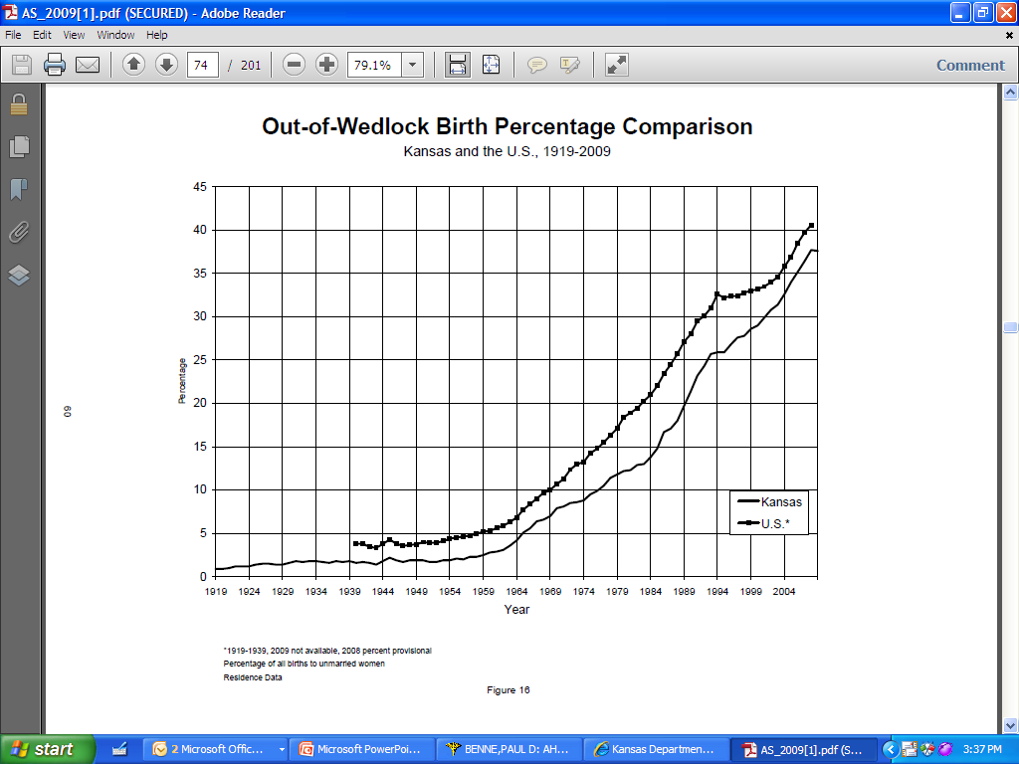
Source: Kansas Annual Summary of Vital Statistics, 2009

Slide 26
Summary
  KS IMR is higher than in most other states
    Rates are higher in KS than U.S. for all race and ethnic groups (especially Black NH)
Causes of infant deaths mimic those in other states: Prematurity and LBW are key factor
Fort Riley facility IMR significantly lower although high risk referred outside facility
Protective effect against infant mortality particularly for Black NH in the military setting and consistent with other study on preterm delivery

Slide 27
Support Partner Programs
Kansas Blue Ribbon Panel on Infant Mortality
PPOR analysis from KDHE
FIMR programs in the state
March of Dimes
  Prematurity conference
  Prematurity Coalition
SIDS Network of Kansas
  Safe Sleep video
  Presentation at Conferences KAAP, KAFP

Slide 28
Acknowledgements:
SPC John Makinwa
US Army, Fort Riley
Mr. Greg Crawford
Ms. Jamie Kim
Ms. Carol Moyer
Kansas Department of Health and Environment
Dr. Dennis Cooley
Kansas Blue Ribbon Panel on Infant Mortality
Point of Contact for Study:
Paul Benne, MD, MPH
Lieutenant Colonel, Medical Corps
600 Caisson Hill Rd
Fort Riley, KS 66442
785 239 7323

